Slide 1

Customer Reviews Analysis & Marketing Informatics report
By Islam Omar
12/12/2023

Slide 2
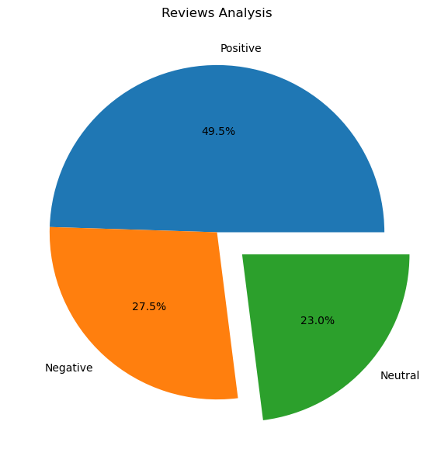
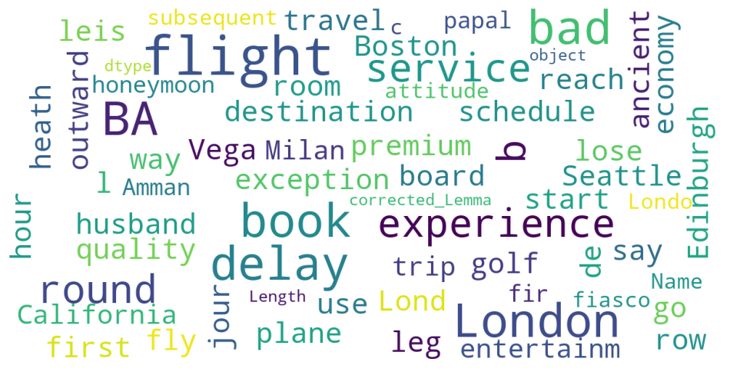
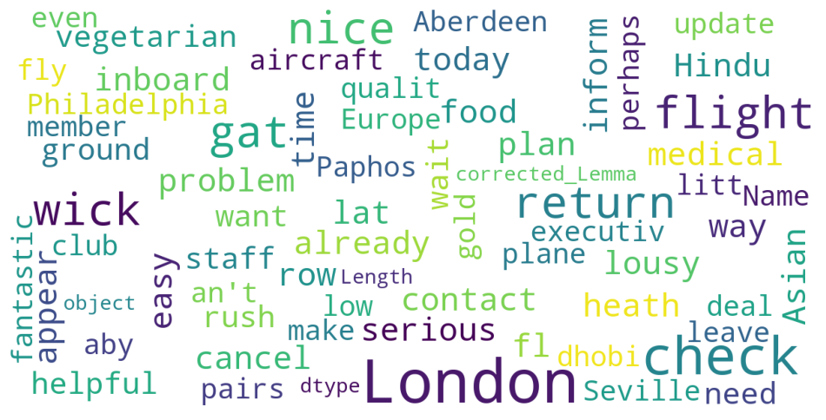
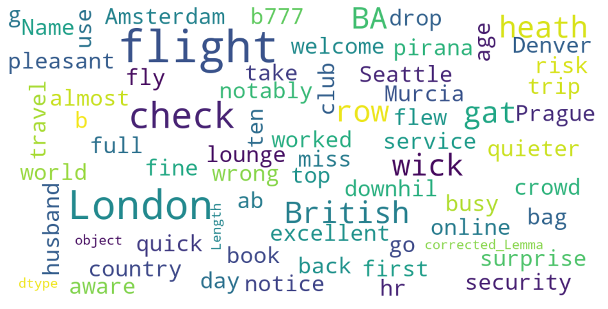
Sentiment Analysis Results
Word Cloud of the most used words in Negative Reviews
Word Cloud of the most used words in Positive Reviews
Word Cloud of the most used words in Neutral Reviews

